Slide 1
Updates 6/11/20
Akash Levy

Slide 2
Overview
Final numbers for algorithm comparison
Endurance on 256 cells
Results on one WL from chip 2
Updated plots for infinite range

Slide 3
Algorithm Comparison (4WL, chip 1)
Algorithm (change option names appropriately) | Avg. # of pulses for 99%
SDCFC Infinite Coarse Range (optimal) | 3.52
SDCFC Option 4 | 3.54
SDCFC Option 1 | 3.58
SDCFC Option 2 | 3.78
SDCFC Option 3 | 4.40
FPPV (-11%) | 6.43
ISPP | 9.19
FPPV (original) | -

Slide 4
BER Plot Updated

Slide 5
BL Optimization Plot (Smoothed)
Optimal Point: (Step, Start) = (0.54V, 2.0V)
# Pulses Req: 3.36, Success Rate: 100%
Introduced box filter smoothing to make the plot look nicer

Slide 6
SL Optimization Plot (Range3)
Optimal Point: (Step, Start) = (0.11V, 0.6V)
# Pulses Req: 2.91, Success Rate: 99.6%

Slide 7
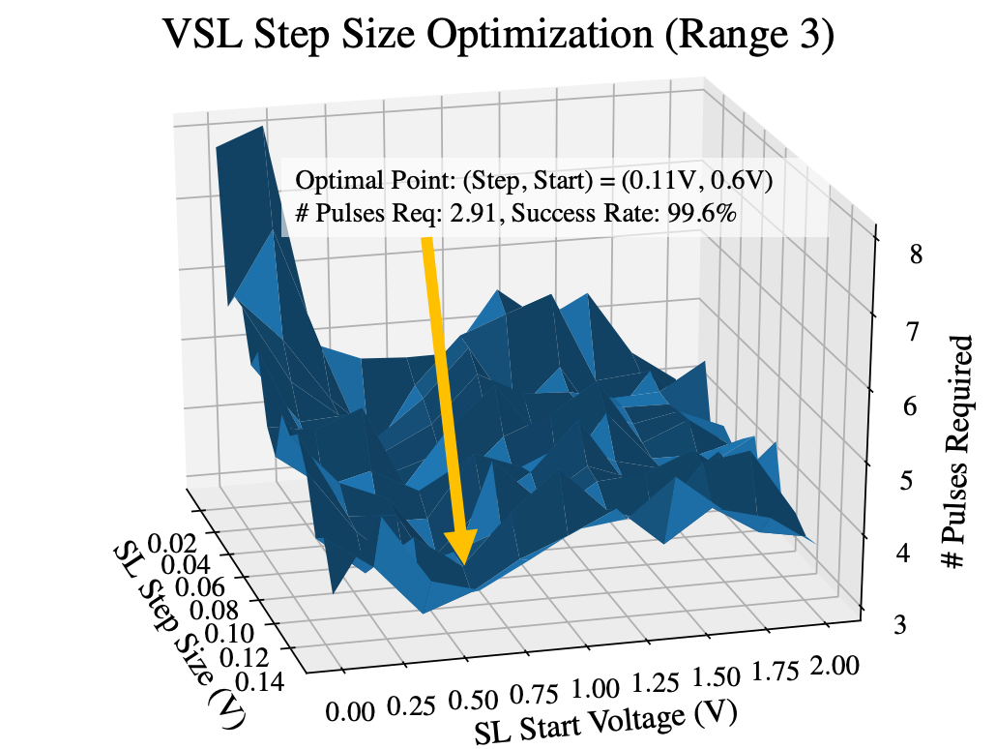
SL Optimization Plot (Range 3, Figure For Paper)

Slide 8
Optimized SDCFC Parameters (Infinite Range)
Range | VSL Start (V) | VSL Step (V) | VBL Start (V) | VBL Step (V)
0 | 0.4 | 0.09 | 2 | 0.22
1 | 0.4 | 0.14 | 2 | 0.62
2 | 0.6 | 0.09 | 2 | 0.66
3 | 0.6 | 0.11 | 2 | 0.42
4 | 0.4 | 0.12 | 2 | 0.54
5 | 0.8 | 0.14 | 2 | 0.18
6 | 0.8 | 0.13 | 2 | 0.26

Slide 9
Algorithm Comparison (1WL, chip 2, no tuning)
Chip 2 appears to be doing slightly worse than chip 1
Re-optimization of algorithms seems to be necessary
NOTE: FPPV (-11% cells) is not actually shown
Algorithm | Avg. # of pulses for 99%
SDCFC | 4.77
FPPV (-11%) | -
ISPP | 9.82
FPPV (original) | -

Slide 10
Preliminary Algorithm Endurance Results
256 cells on chip 1
Cycled 20K times
Not all cells go from range 7 to range 0
Finished updated pulse waveform that produces proper results by generating SET pulses across addresses instead doing SET/RESET cycles for one cell
SDCFC Option 1: ~4 pulses gets to 99% accuracy!
Looking pretty good

